Slide 1


Hope to Skills
Lecture# 24
Irfan Malik, Dr. Sheraz Naseer

Slide 2
Agenda
Limitations of simple Neural Network
Convolutional Neural Networks (CNN)
Basics for CNN
Images and features
Convolution
Pooling
Quiz

Slide 3
Limitations of Simple Neural Networks
Pixel Equality: Simple neural networks treat all pixels in an image equally, regardless of their spatial relationships or positions
High Dimensionality: Large sized Image have more pixels and model needs more weights to learn. 28x28=784, 256x256=65536
Limited Feature Extraction: Simple networks lack specialized layers to automatically extract relevant features from images, making it harder to identify complex structures
Large Computational Requirements: Larger no of weights requires more computational resources to train.

Slide 4
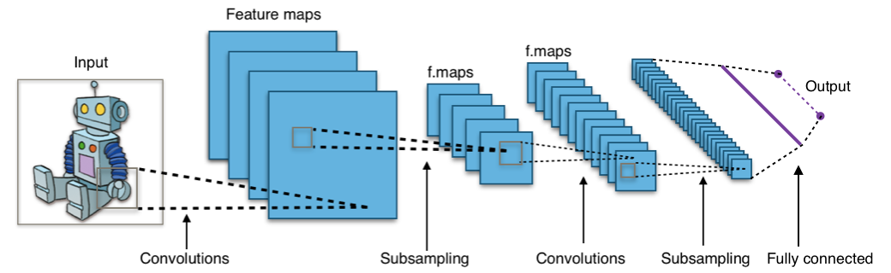
Convolutional Neural Networks (CNN)
CNNs are a type of Neural Networks inspired by how our brain processes visual information.
They're specialized for understanding images, making them powerful tools in image analysis, recognition, and more.

Slide 5
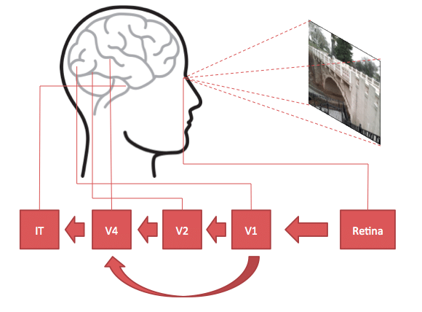
Brain to AI: Visual Cortex

Slide 6
Images in Computer

Slide 7
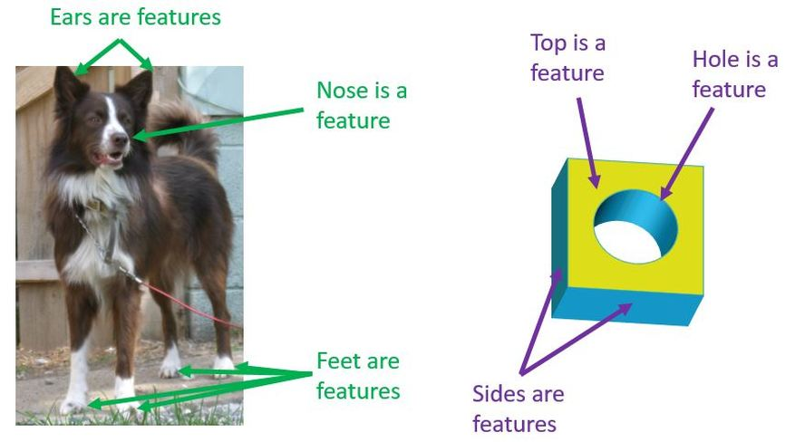
Features for Images
Images are full of important parts called features.
Features can be edges, textures, shapes, or even faces.

Slide 8
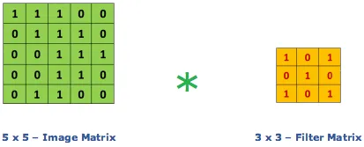
Convolution
Convolution is like a special way of looking at data. It's a mathematical operation that brings out patterns.
The filter slides over the image, one small piece at a time.

Slide 9
Convolution

Slide 10

Filter as Magnifier

Slide 11
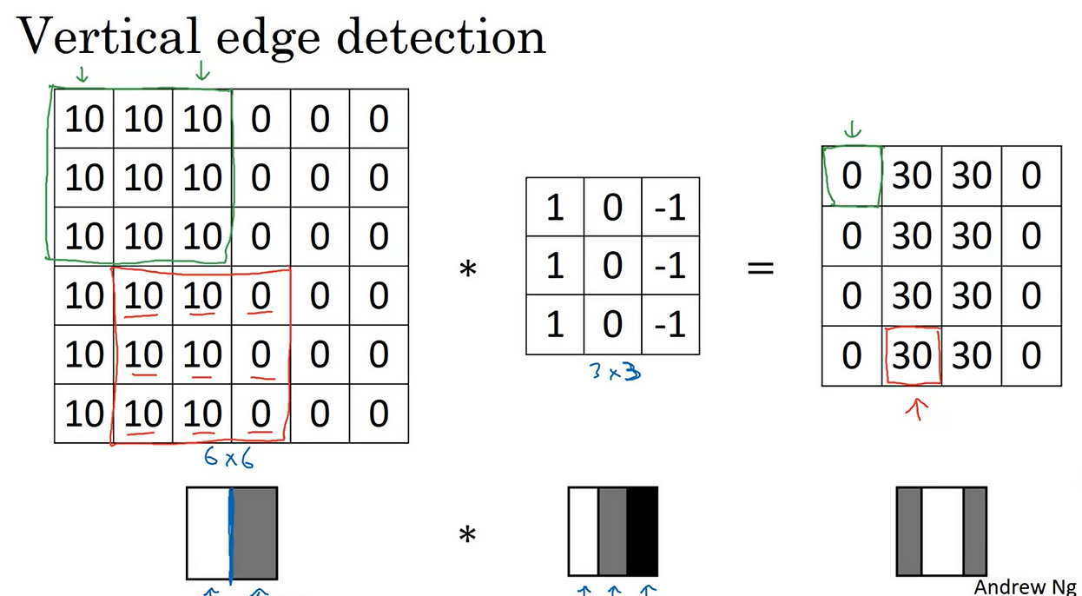

Slide 12
Convolution

Slide 13
Pooling
Pooling is like summarizing information, keeping what's important.
It helps reduce the dimensionality while retaining important information.
Pooling = Downsizing + Information Summary.

Slide 14
Types of Pooling

Slide 15
Types of Pooling

Slide 16
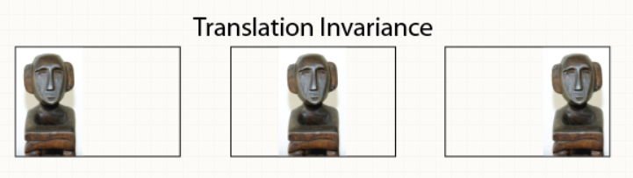
Advantages of Max Pooling:
Feature Retention: Keeps dominant features intact.
Translation Invariance: Recognizes features regardless of exact location.
Dimension Reduction: Reduces data size, providing efficiency.

Slide 17
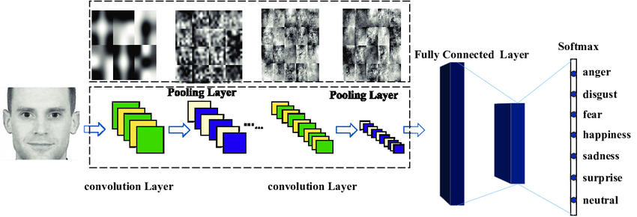
CNN Architecture

Slide 18
CNN Architecture

